Slide 1
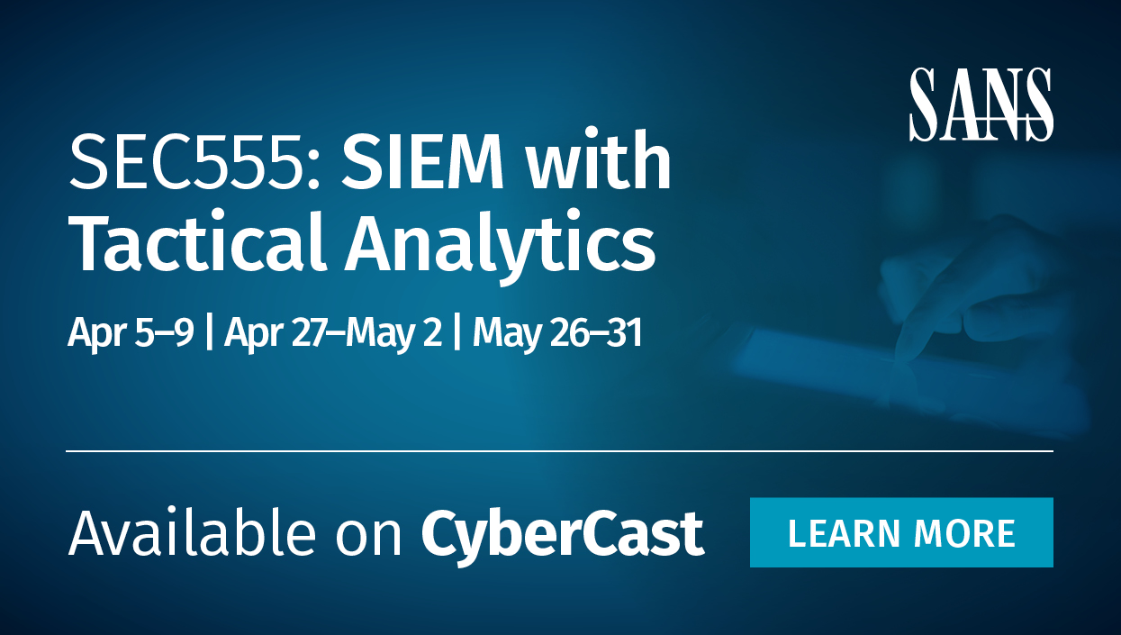
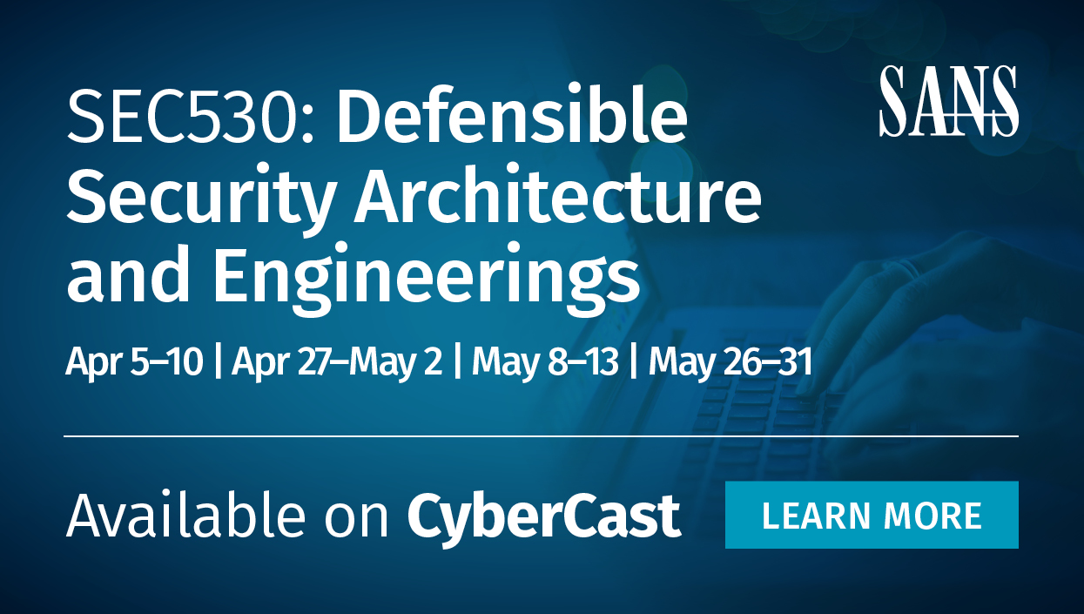
Upcoming Classes

Slide 2
SEC530
Defensible Security Architecture and Engineering
Container Security: Building a Solid Foundation for All Round Defenders
Justin Henderson (GSE # 108)
@SecurityMapper

Slide 3

About Me
Author of SEC555: SIEM with Tactical Analytics
GIAC GSE # 108, Cyber Guardian Blue and Red
61 industry certifications (need to get a new hobby)
Two-time NetWars Core tournament winner (offense)
And security hobbyist and community supporter
Collecting interns/contributors
Release research to the community
See https://github.com/HASecuritySolutions

Slide 4
Welcome!
A copy of this talk is available at: https://github.com/HASecuritySolutions/presentations
More free stuff: https://github.com/HASecuritySolutions

Slide 5
Container Security
Presentation broken into three sections:
Hardening and Best Practices
Monitoring
Forensics and Incident Handling
Goal is to rapidly gain knowledge on container security

Slide 6

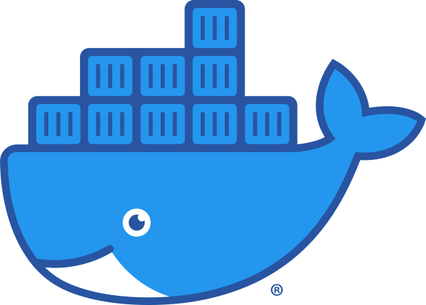

Container Architecture
/var/log/apache2
Containers
/var/log/mysql
access.log
error.log
error.log
Apache
MySQL
mysql.log
mysql-slow.log
Apache
JavaApp
Nginx
Legacy
Layers may be substituted with container platform
Docker Service
/var/log/upstart
docker.log
Host OS

Slide 7
Host Operating System
Container OS
General Purpose
Fedora CoreOS
CentOS Atmoic
Ubuntu Core
Rancher OS
VMware Photon
Smaller attack surface
- Limits installed software
Windows Server 2019
RedHat
CentOS
Ubuntu Server
Contains unnecessary software and services
- Larger attack surface

Slide 8
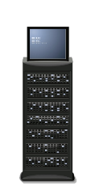
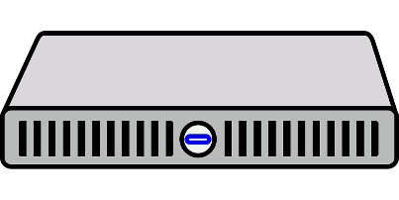
Physical Separation
Separate host deployments should be considered based on:
Data sensitivity
Compliance requirements
Risk of VM compromise
Separation includes:
Different container networks
Different physical servers
Potentially different clusters (swarm or Kubernetes)
DMZ
Internal

Slide 9
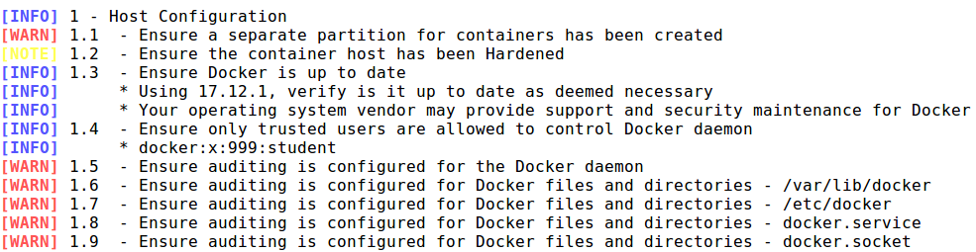
Vulnerability Scanning and Auditing
Some vulnerability scanners are unable to handle container platforms
May require commercial tools
Or specific open source projects
docker-bench-security is an open source auditing tool

Slide 10




Container Escape / Privilege Escalation
Risk of privilege escalation is greater with containers
Container shares host kernel
Container lives in namespace(s) available on host
Possible to escape out of container into host
And further possible to escape one namespace to another
Ubuntu Host OS
CentOS Container

Slide 11
User Namespaces
Container services rely heavily on Linux namespaces
Example: PID namespace isolation blocks child processes from knowing of their parent processes
Default container namespace allows root access
Login as standard Linux user
Run “docker run -it -u root -v /:/hostfs centos”
Inside container add your account to sudo group
Fix is to switch to user namespaces or rootless mode
Such as userns-remap (caution - requires redeployment)

Slide 12
Malicious Images
Docker containers deploy from an image
Most images come from Docker Hub
Docker Hub is free and allows community images
Images can contain malicious content, so trust is an issue
Use Docker Content Trust¹ (defaults to on for Docker 1.9+)
export DOCKER_CONTENT_TRUST=1
Only allows signed docker containers to run
Alternative to signing is using Automated Build images

Slide 13
Registries and Images
Containers are deployed from an image
Images are pulled from either a public or private registry
docker pull nginx
docker pull private.sec530.com/nginx
Pull from hub.docker.com
Authenticated pull from private registry

Slide 14
Control Groups (CGroups)
Containers can use consume entire hosts resources
Makes them vulnerable to denial-of-service
Possible to limit resources on a per container basis
docker run -m 512m --memory-swap 1g
docker run -m 512m --memory-swap 512m
docker run --cpus="1.5"
docker run --storage-opt size=100G
docker run --ulimit nofile=10000:10000

Slide 15
Secrets
Passwords, encryption keys, and other sensitive data may be necessary for a container
Containers often span multiple hosts
Secure transmission and storage is necessary
Docker swarm¹, Docker compose², and Kubernetes³ support secrets
Sensitive data is stored by management service
Data is encrypted during transit to container and at rest

Slide 16
Protecting Against Container Escape
Run containers as standard Linux users
-u flag can force the container to run as a specific user
Run services in containers as standard Linux users
RUN useradd -ms /bin/bash service_account USER service_account
Remove SUID and SGID use in container images
Simple adjustment to Dockerfile or image build RUN for i in `find / -perm +6000 -type f`; do chmod a-s $i; done

Slide 17
Logging with Container Technologies
Log collection and analysis of containers revolves around three main areas
Container service logs (Docker, containerd, Kubernetes)
Host operating system or platform logs (not covered in this talk)
Service logs of container application(s)
Each of the above are different for collection and analysis
And you likely want them all

Slide 18

Container Service Logs
Service daemon such as a Docker daemon records key events such as:
Daemon events (errors, status, and general events)
Calls to remote APIs (Example: docker service ls)
Jan 08 23:52:59 sec555 dockerd[4418]: time="2020-01-08T23:52:59.517125078-05:00" level=debug msg="Listener created for HTTP on fd ()“
Jan 08 23:52:59 sec555 dockerd[4418]: time="2020-01-08T23:52:59.519956507-05:00" level=info msg="libcontainerd: started new docker-containerd process" pid=4448

Slide 19

Amazon EKS Control Plane Logging
For example, Amazon EKS allows logging daemon events to CloudWatch
aws eks --region us-west-2 update-cluster-config --name prod \
--logging '{"clusterLogging":[{"types":["api","audit","authenticator","controllerManager","scheduler"],"enabled":true}]}’
Logs can then be viewed or pulled from CloudWatch
Example: EKS -> CloudWatch <- Logstash -> Elasticsearch

Slide 20
Container Logging
Four common options for collecting logs from containers
Persistent data volume or bind mount
Example: S3 bucket, google storage bucket, etc.
Application inside container (custom coding)
Monitoring container (“sidecar”)
Daemon log drivers
Example: Amazon log driver to S3 or CloudWatch

Slide 21
Persistent Data Volume / Bind Mount
Containers are often non-persistent (can be destroyed)
But data can be shifted to persistent location
Syslog or agent can ship of logs directly on the Host OS
Nginx
Host Ubuntu
Resides on
/var/log/nginx
/logs/customapp1/nginx
Writes on host to
access.log
access.log
error.log
error.log

Slide 22
Container to Container Logging (“sidecar”)
One container can see another’s logs
One-to-one or One-to-many possible
Nginx
Host Ubuntu
Resides on
/var/log/nginx
/logs/customapp1/nginx
Writes on host to
access.log
access.log
error.log
error.log
Logging Container
Has volume or bind mount to
/var/log/nginx
access.log
error.log

Slide 23
Log Driver Configuration
Log driver supports multiple options
And each container can use a different log driver
version: '2.2'
services:
apache:
image: httpd
container_name: apache
logging:
driver: "json-file"
options:
max-size: "200k"
max-file: "10"
Sample log section in docker-compose.yml
Also works in cloud providers using log drivers Example: AWS awslogs
Notes:
/var/lib/docker/containers

Slide 24
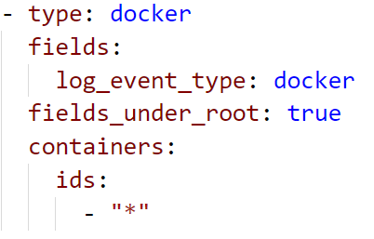
Dynamic Log Agents
Log agents may support auto discovery of containers
Filebeat integrates with docker to log all containers
Can look for specific applications and collects their logs
Works by monitoring /var/lib/docker
Can be deployed into cloud services such as Amazon EKS

Slide 25
Forensics and Incident Handling
Containers are ephemeral in nature
Able to mass deploy, delete, redeploy, etc.
Reword: “Containers do not permanently run”
Compromise requires investigation and careful planning
Stopping a container often deletes it
Data acquisition is different than a virtual machine
Lack of software in images limits tool availability

Slide 26
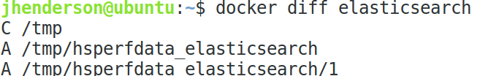
Auditing and Logging
Containers are short lived making auditing more important
docker diff shows container changes from its image
Log collection requires mounting folder to container
docker run -v /logs/nginx1:/var/log/nginx/ nginx
Syslog or collection agent on host can ship off logs
docker commit can make a snapshot for incident response

Slide 27

Memory Acquisition
Containers are processes running with isolation
Means host has direct access to dump memory contents
Requires dumping each process’s memory
Possible to use multiple process memory dumping tools
Easy to do inside host operating system
Cloud environments may require using “docker exec”

Slide 28
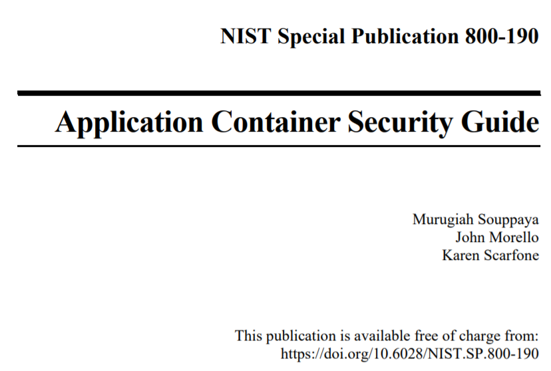
NIST 800-190
NIST 800-190 is the Application Container Security Guide

Slide 29


Presentation based on SEC530: Defensible Security Architecture and Engineering
Thank you!!
References
https://sans.org/sec530
Notes:
There’s a lot more we could talk about... Check out SEC530.

Slide 30
Upcoming Classes

